Slide 1





SMART/AUTOMATE IRRIGATION USING
SOIL MOISTURE AND WEATHER DATA
NAME:ARCHANA J DEV
AICTE Student ID: STU6837174faa7e41748440911
AICTE Internship ID: INTERNSHIP_175040797468551b2636342

Slide 2

Learning Objectives
Automate Irrigation Decisions
Predict which sprinklers should be ON or OFF based on sensor inputs.
Utilize Historical Data for Smart Predictions
Train a machine learning model using past sensor readings and sprinkler
actions.
Provide an Interactive Web Interface
Allow users to simulate sensor values via sliders and get instant predictions.
Optimize Water Usage in Agriculture
Ensure irrigation is only triggered when needed, reducing water wastage.
GOAL
Source :
www.freepik.com/

Slide 3
Tools and Technology used
Programming Language & Environment
Python 3.12.8
Jupyter Notebook (for model training)
VS Code (for coding & Streamlit app)
Machine Learning Algorithm
RandomForestClassifier inside MultiOutputClassifier
(for multi-sprinkler prediction)
Libraries Used
pandas, numpy → Data handling & preprocessing
scikit-learn → Model training, normalization, and evaluation
joblib → Model saving and loading
streamlit → Web app interface
Supporting Tools
MinMaxScaler → Normalizing sensor data (0 to 1)
Joblib .pkl file → Stores trained model for predictions

Slide 4
Methodology
Problem Understanding & Approach
Aim: Predict sprinkler ON/OFF using historical sensor data to simulate a smart irrigation system.
Data Collection
Used the historical irrigation dataset containing 20 sensor readings and 3 sprinkler outputs (ON/OFF).
Data Preprocessing
Removed unnecessary columns.
Normalized sensor values between 0 and 1 using MinMaxScaler.
Exploratory Data Analysis (EDA)
Checked dataset structure with .head() and .info()
Verified class balance and sensor value ranges.
Model Training & Evaluation
Split dataset into training (80%) and testing (20%) sets.
Trained RandomForestClassifier inside MultiOutputClassifier for multi-sprinkler prediction.
Evaluated using classification report.
Model Saving & Integration
Saved the trained model using joblib as Farm_Irrigation_System.pkl.
Integrated it into the Streamlit web app (app.py).
App Development & Deployment (Simulation)
Created Streamlit app with 20 sliders for sensor simulation.
Predict button displays sprinkler ON/OFF with colored emojis.
Launched locally using streamlit run app.py.

Slide 5
Problem Statement:
Uncertainty in Irrigation Timing
Farmers often don’t know the exact time to water crops, leading to overwatering or underwatering.
Manual Monitoring of Soil & Environment
Checking soil moisture, temperature, and other conditions manually is time-consuming and
inaccurate.
Water Wastage in Traditional Farming
Continuous or untimely irrigation causes unnecessary water usage, reducing efficiency.
Lack of Data-Driven Decision Making
Farmers rarely use historical sensor data to optimize irrigation schedules.
Need for an Automated Decision System
A system is required to analyze environmental data and suggest which sprinklers should be ON/OFF.

Slide 6
Solution:
Smart Irrigation System equipped with 20 environmental sensors and 3 automated sprinkler pumps to assist in crop watering.
Machine Learning model predicts which sprinklers should be ON/OFF based on the 20 sensor values.
Streamlit simulation app with sliders for all 20 sensors allows users to simulate environmental conditions.
Automated irrigation decision-making reduces manual effort and optimizes water usage efficiently.
GITHUB LINK:
https://github.com/arcchhh/smart-irrigation_AICTE_shell.git

Slide 7
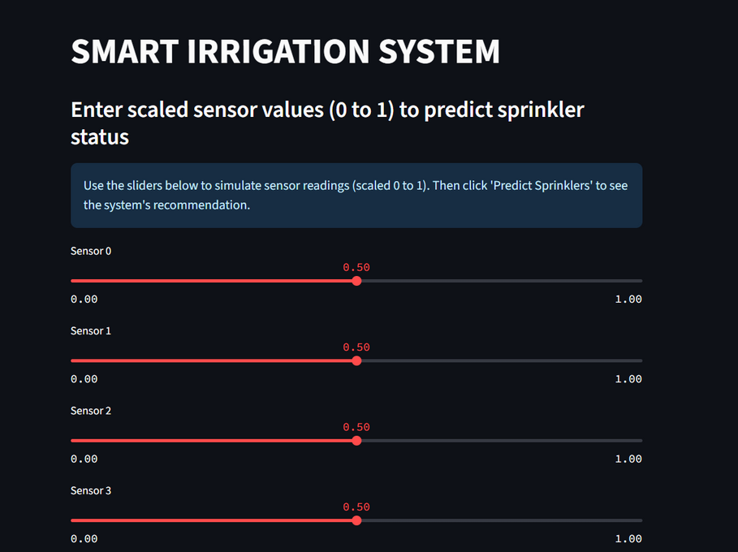
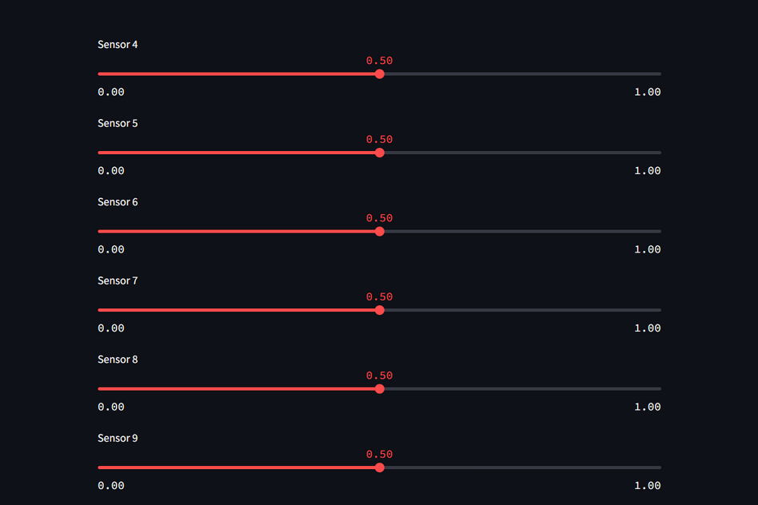
Screenshot of Output:
Streamlit-based Smart Irrigation Simulation: Sensor inputs via sliders and automated sprinkler ON/OFF predictions with visual indicators.

Slide 8
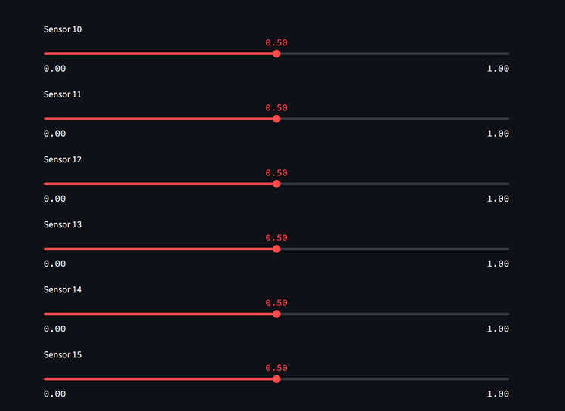
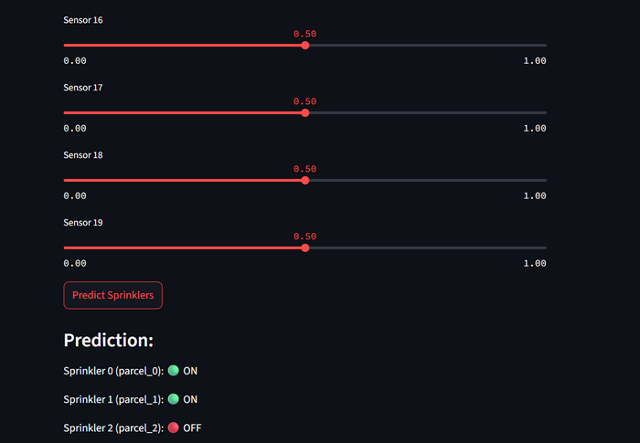
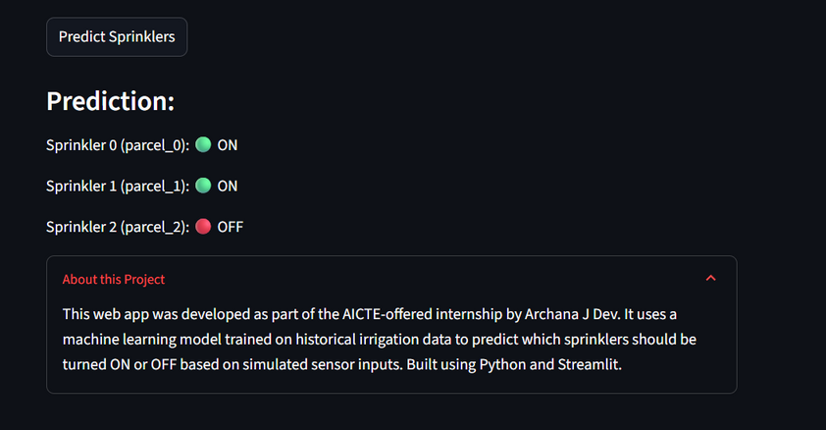
Screenshot of Output:

Slide 9
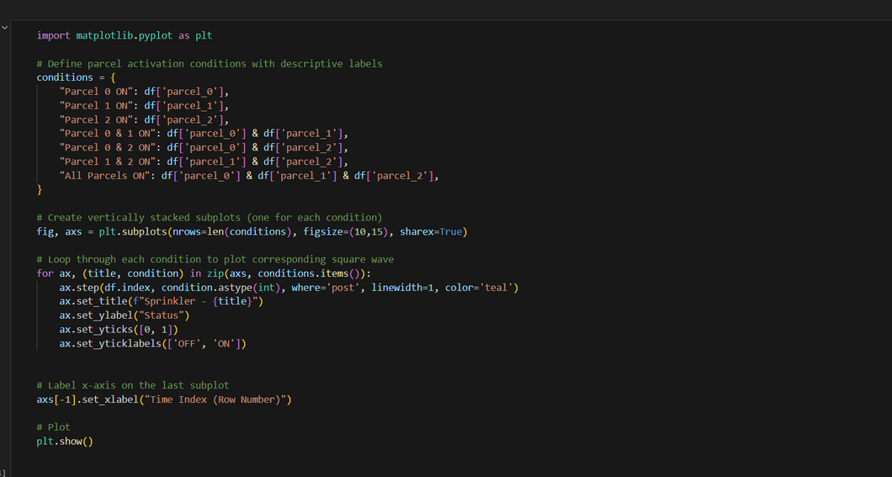
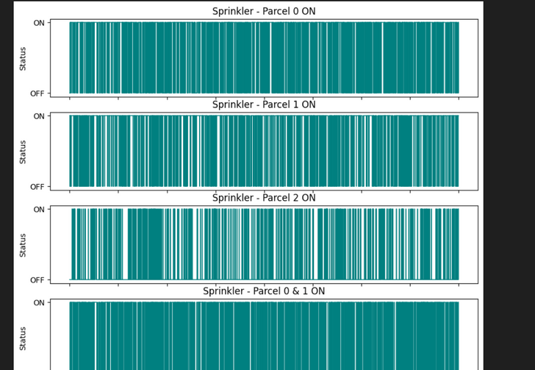
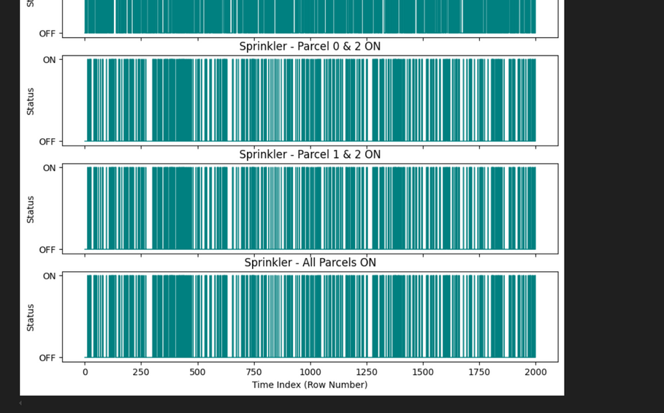
Screenshot of Output:
Sprinkler activation patterns over time showing ON/OFF status
for different parcel combinations.

Slide 10
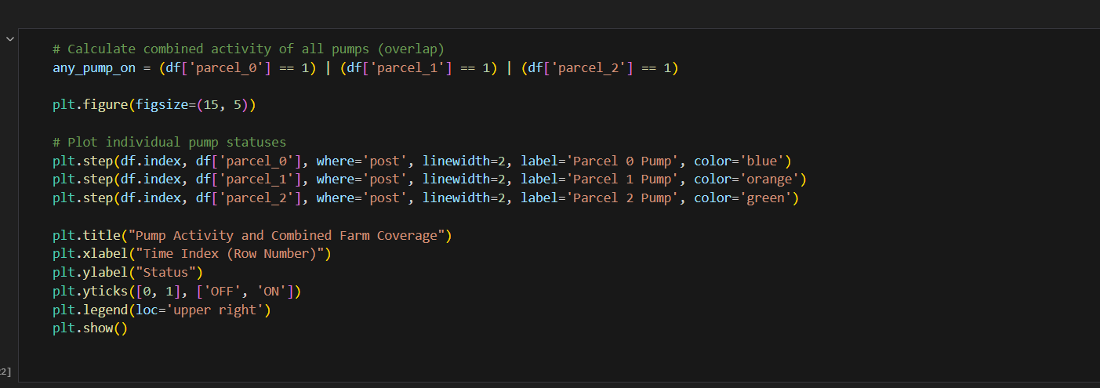
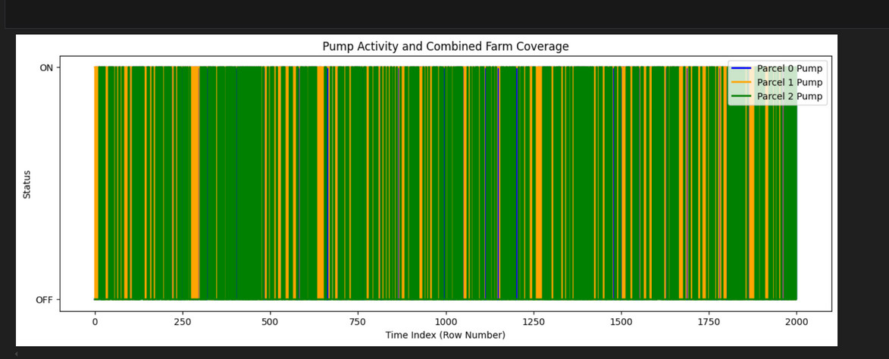
Screenshot of Output:
Combined pump activity visualization showing ON/OFF status of
Parcel 0, 1, and 2 pumps over time.

Slide 11
Conclusion:
Project Summary
Utilized a historical irrigation dataset with 20 sensor values and 3 sprinkler outputs (ON/OFF) for training.
Performed data preprocessing including dropping index/unnecessary columns and normalizing sensor values (0–1).
Trained a MultiOutput Random Forest Classifier to predict sprinkler ON/OFF decisions.
Developed a Streamlit-based simulation app allowing users to input sensor values and view automated irrigation predictions
.
Future Scope
Real-time sensor integration with IoT devices to automatically fetch live readings instead of manual slider input.
Automatic sprinkler control for fully autonomous irrigation instead of just simulation-based predictions.

